Slide 1
METROBIKE AUSTIN TRIPS
STA380 Introduction to Machine Learning – Project
Chyavan Mysore Chandrashekar | CM65624
Pratik Gawli | PBG397
Rukh Agha | MSA3453
Spoorthi Anupuru | SA56643
Tanushree Devi Balaji | TB33857

Slide 2







Agenda
DATA DESCRIPTION
DATA CLEANING
REGRESSION
K – NEAREST NEIGHBORS
BAGGING RANDOM FOREST
BOOSTING
INSIGHTS AND RECOMMENDATION

Slide 3
Data and Attributes
Data Source – Metrobike Austin: Trips
Time frame – 2013 to 2022
Size – 1.6M Rows
https://data.austintexas.gov/Transportation-and-Mobility/Austin-MetroBike-Trips/tyfh-5r8s

Slide 4
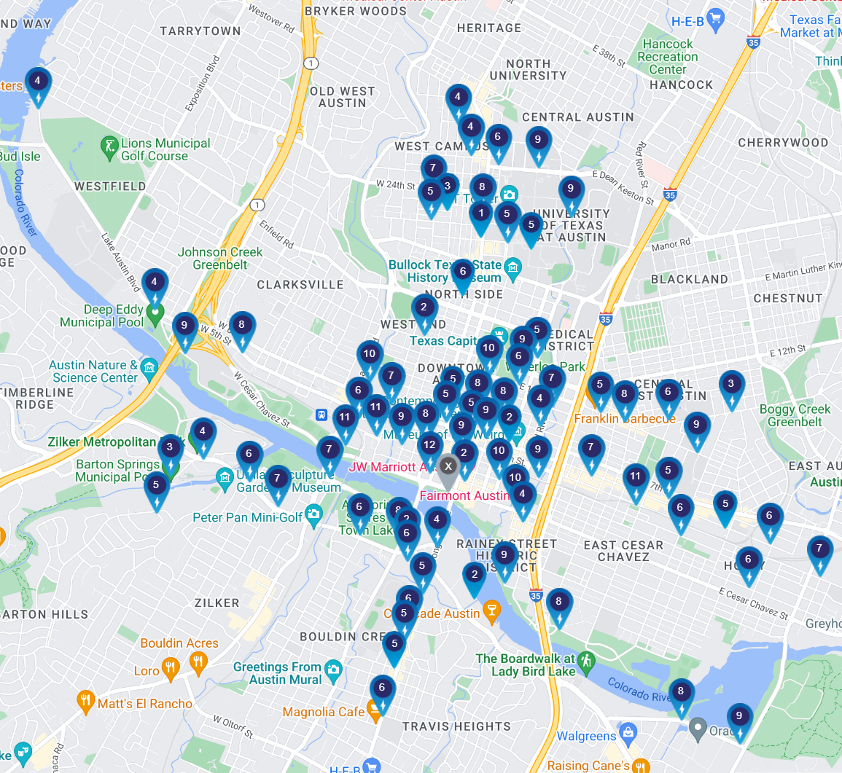
https://austin.bcycle.com/stations

Slide 5
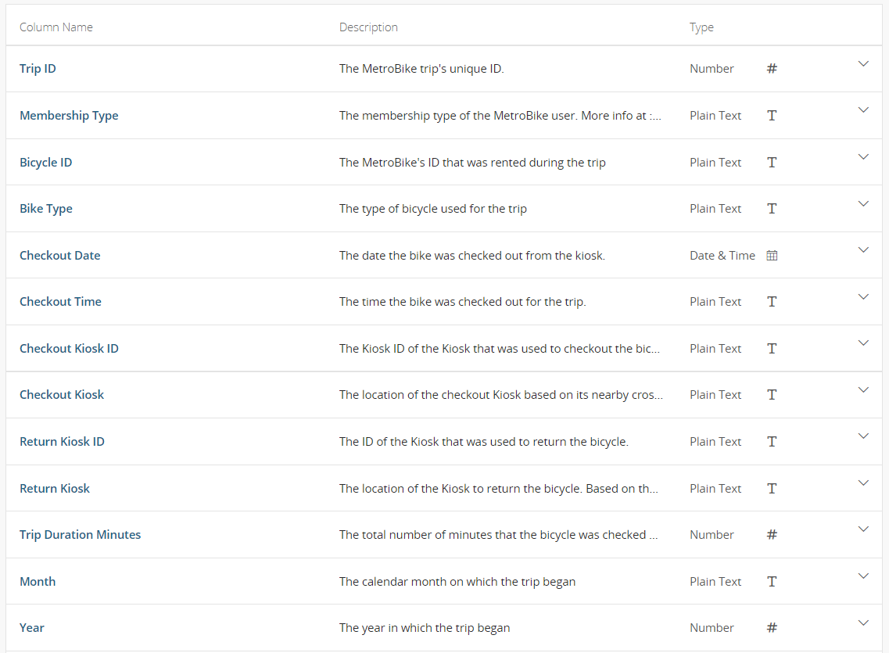

Slide 6





What columns will we be considering?
Length of Trip
Location of the Checkout Kiosk
Average Monthly Temperature
Time of Year
Membership Type

Slide 7

OBJECTIVE
Predict volume of trips at a station in a given month based on:
Station Location
Avg Length of Trips at Station
Customer Type
Temperature
The Month Itself!
And to offer potential recommendations for:
Segment Marketing
Supply Logistics

Slide 8




Data Cleaning
75%
Training Data
25k
Raw Data
Dropped Nulls & Filtered for Top 9 Member Types
Created Dummy Variables for Month (Categorical)
Aggregated the Data at Desired Granularity
#Rows
1.6M
1.3M
34k
25%
Test Data
9k

Slide 9
Regression

Slide 10
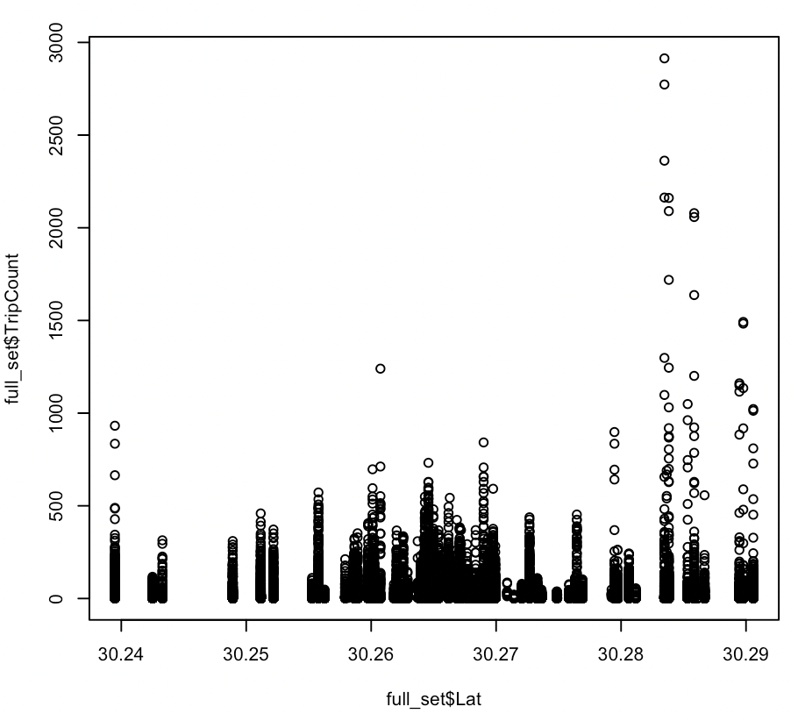
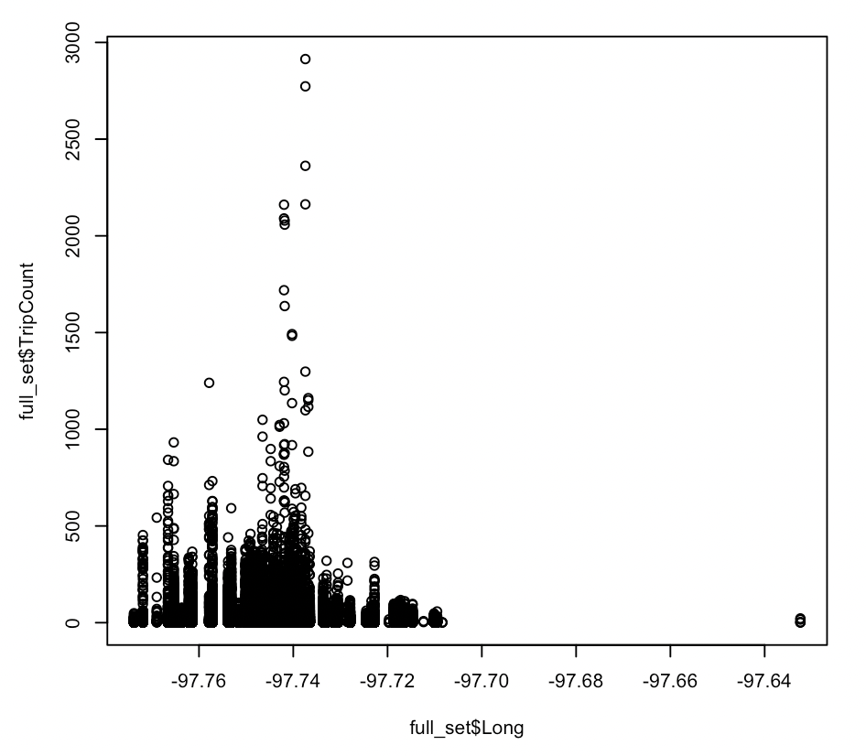
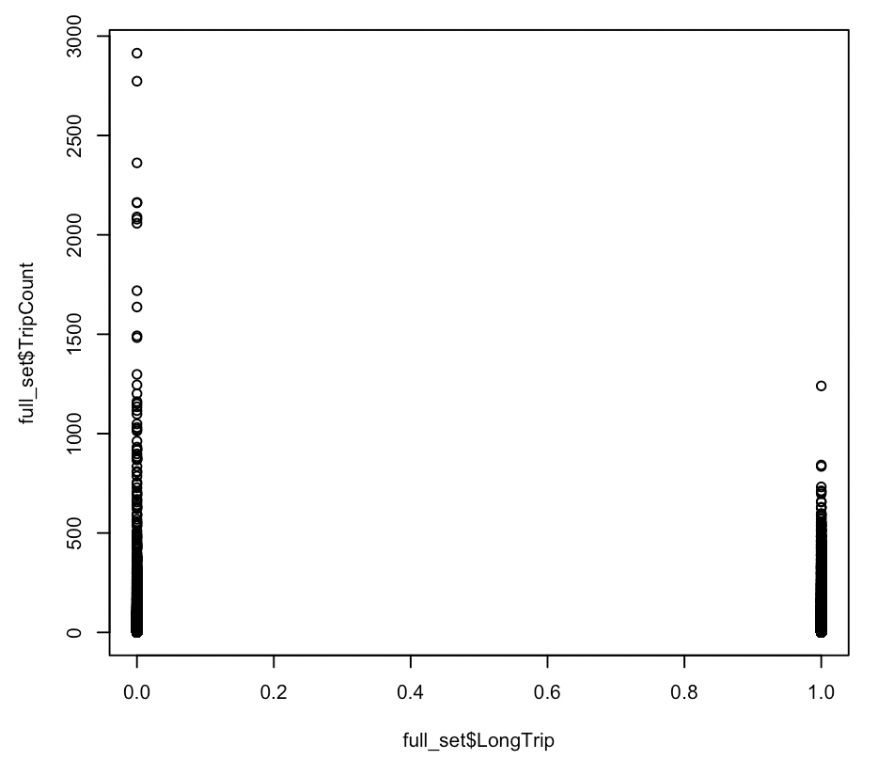
Predictor Trends
The first step was to understand the relationship between trip volume and the predictors. Based on the plots below, fair to say that there are no clear-cut linear relationships
Latitude
Longitude
is_Long_Trip

Slide 11
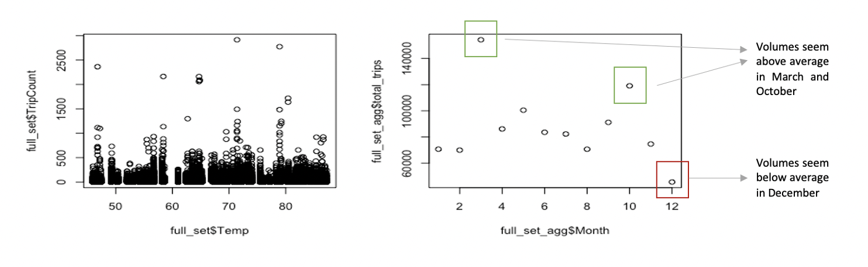
Predictor Trends (Contd.)
The first step was to understand the relationship between trip volume and the predictors. Based on the plots below, fair to say that there are no clear-cut linear relationships

Slide 12
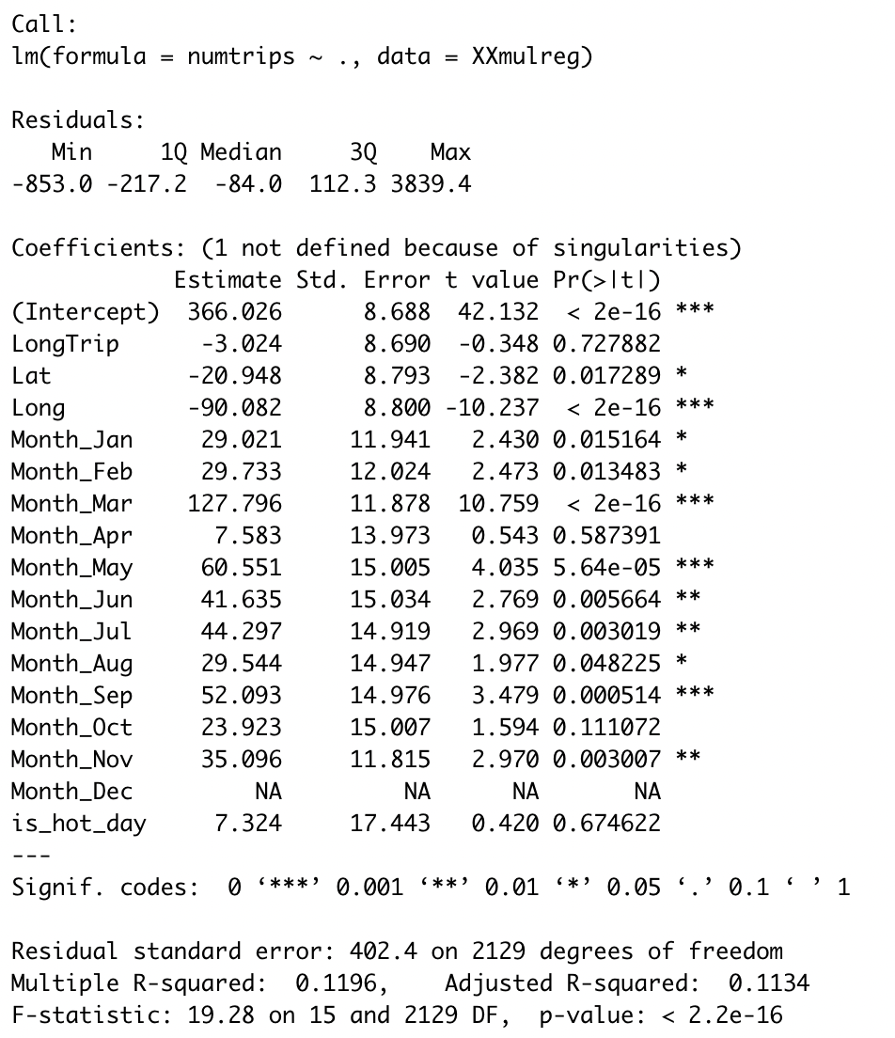
Multiple Linear Regression
Despite the lack of a visible linear relationship, multiple linear regression felt like a good starting point to get a sense of the data
At first look, you notice:
Low R square
Most of these variables are insignificant and have low t-values

Slide 13
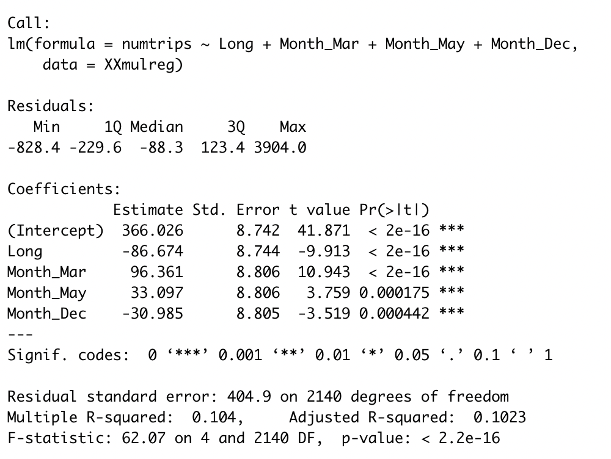
Multiple Linear Regression (Contd.)
Fine tuning this model, the results are as shown below:
With this model, you notice:
Trade off between complexity and R Square
Variables dictating trip duration and temperature are gone
Maybe, these variables are not meaningful as stand-alone predictors

Slide 14
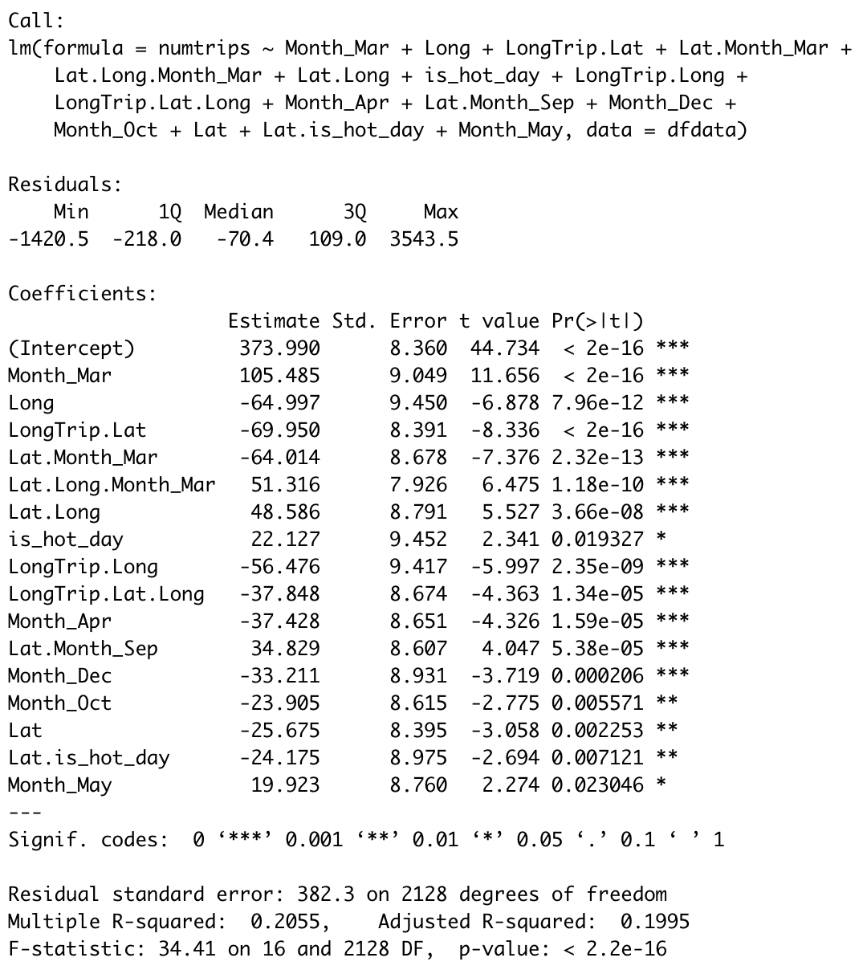
Forward Regression
While individual variables may not be able to explain the variability of trip volume on their own, combinations of them might. Below are the results of the forward step regression model:
Information about length of the trip and average temperature become more meaningful estimators of trip volume when combined with geographical information
There is also almost 100% improvement in R square

Slide 15
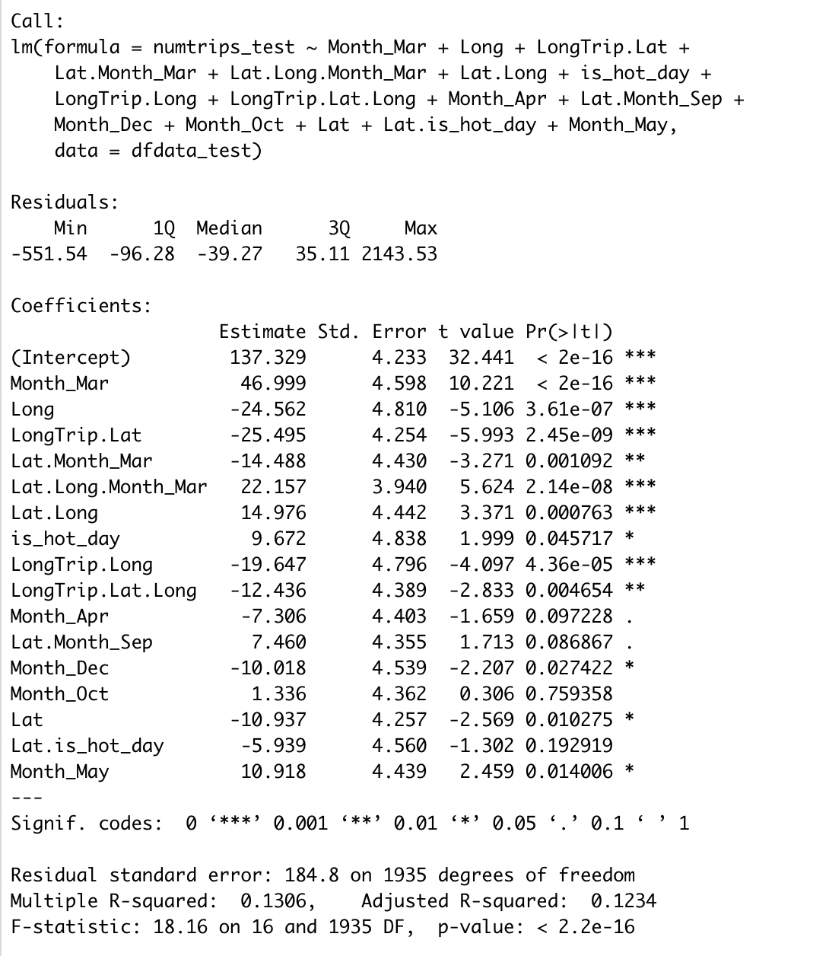
Forward Regression (Contd.)
Validating this same model using test data, the R square takes a considerable hit.
A lot of the previously significant variable are not significant with the test set, indicating possible overfitting on the train set
**Note: that backward and step-wise regressions yielded similar results

Slide 16
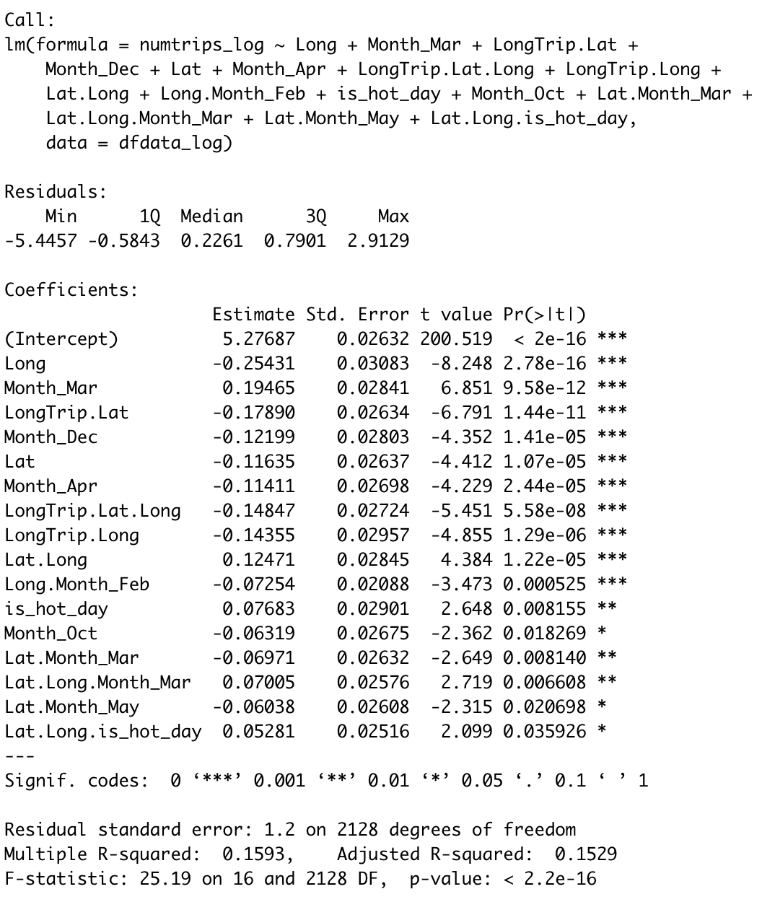
Log Regression
It’s possible that the relationship maybe more exponential than linear. Below are the results of log regression:
R square takes a hit when estimating log of trip volume, without much change in the predictors

Slide 17
What’s Next?
While linear models maybe easy to interpret, they don’t explain the variability in this dataset quite that well.
Next steps could be to:
Test out other linear methods like Ridge and Lasso Regression
Work out non-parametric models to modify the shape of the curve.
This is what we’ll do next and save lasso/ridge for future iterations

Slide 18
K Nearest Neighbors

Slide 19
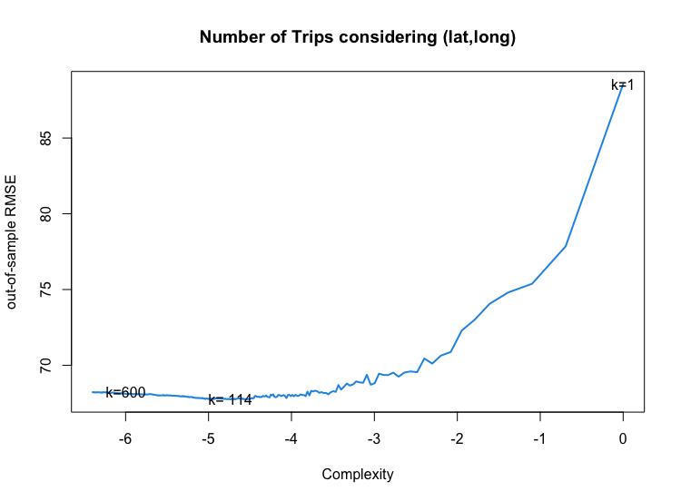
KNN Models
Non parametric model to predict the output variable, requires numeric input variables
Model 1:
Predicting the volume of trips based on Latitude and Longitude:
K fold cross validation used to calculate out of Sample RMSE(K=5); helps to average out the RMSE by testing on 5 different test sets coming from the whole data set.
Minimum RMSE observed(Out of Sample)=67.7 for K= 114

Slide 20

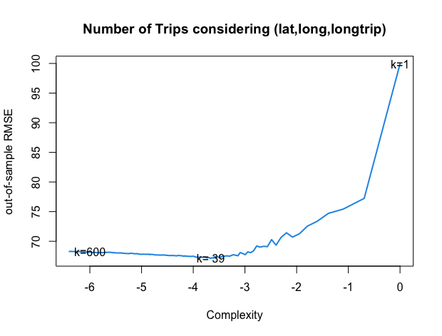
KNN Models contd.
Model 2:
Predicting the volume of trips based on Latitude, Longitude and LongTrip.
Scaling of variables to a common scale required to calculate distances appropriately
Minimum RMSE observed(Out of Sample)=67.1 for K= 39
Improvement from providing only Latitude and Longitude!
for eg:
Short trips from University to Apartment versus Kiosks only used for long trips

Slide 21
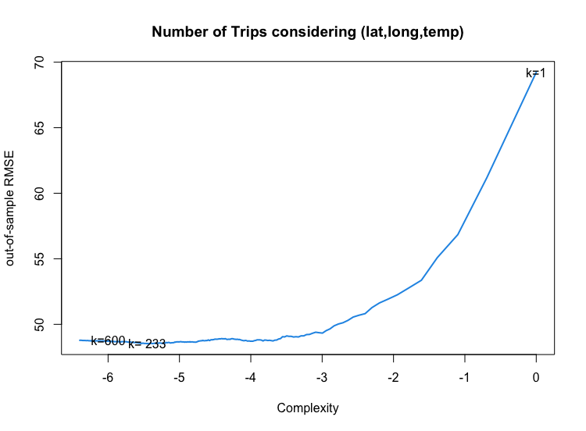
KNN Models contd.
Model 3:
Predicting the volume of trips based on Latitude, Longitude and Temperature.
Scaling of variables to a common scale required to calculate distances appropriately
Minimum RMSE observed(Out of Sample)=48.5 for K= 233
Improvement by providing Temperature as a predictor variable instead of LongTrip. - Makes sense as it provides more numerical information which helps predict the number of trips better, reducing the RMSE.

Slide 22
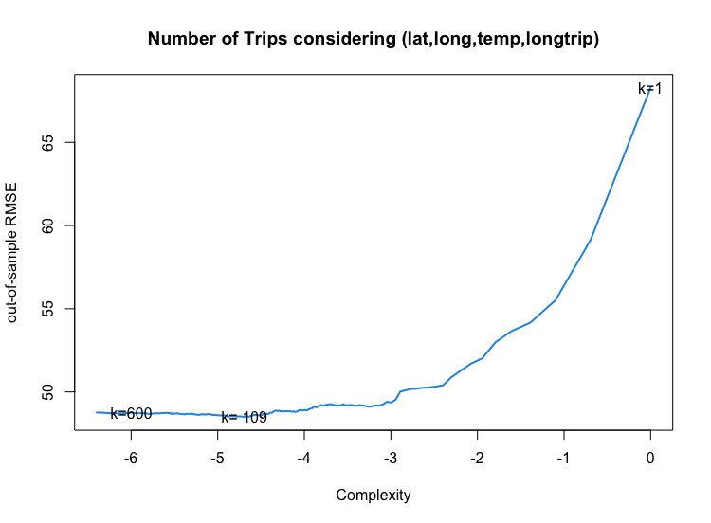
KNN Models contd.
Model 4:
Predicting the volume of trips based on Latitude, Longitude, Temperature and LongTrip.
Scaling of variables to a common scale required to calculate distances appropriately
Minimum RMSE observed(Out of Sample)=48.5 for K= 109
Performance less similar as to including only temperature along with Latitude and Longitude, just number of nearest neighbors required corresponding to minimum RMSE has decreased.
Expected behavior as temperature being highly influential in determining the trip length

Slide 23
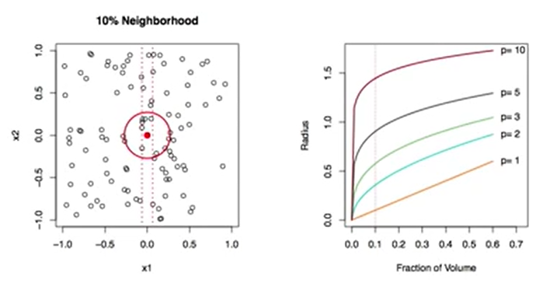
KNN Models - Summary
Best KNN out of Sample RMSE was with the value of 57.8 for K equals 106.
KNN requires numeric type predictor values to calculate distances effectively.
If Membership type and Month,Year need to be included in the predictor set, they need to be encoded as dummy variables.
But performance degrades with increasing predictor variables - Curse of Dimensionality for KNN.
Next up: Testing other non-parametric models to leverage the information of MembershipType and (Month, year) to improve prediction results by reducing RMSE.

Slide 24
Boosting

Slide 25
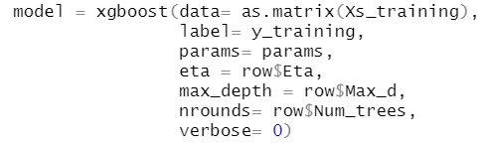
Boosting
In this model, we have the control over
Eta (Lambda) - The shrinkage factor
Maximum depth of the tree
Number of trees
To regress the Y (Volume of Trips) against Xs (Latitude, Longitude, Temperature, Trip Length*, Membership Type*, Month of the year*) we are using a package called XGBoost, which stands for Extreme Gradient Boosting - a gradient-boosted decision tree (GBDT) library.

Slide 26
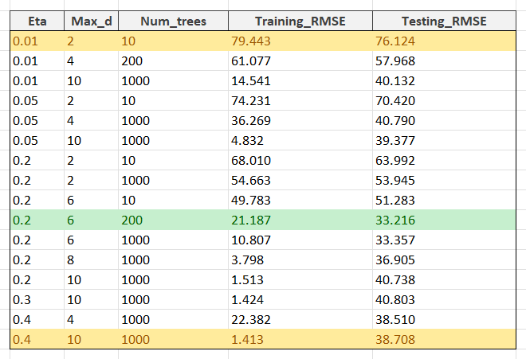
Boosting
In this model, we have the control over
Eta (Lambda) - The shrinkage factor
Maximum depth of the tree
Number of trees

Slide 27
Boosting
We obtained the minimum RMSE for the Validation data set for the values highlighted in green.
As we can see, the minimum training error can be minimized as we make the model more complex, but the minimum RMSE for the Validation data set for the values highlighted in green, which necessarily are not associated with the most complex model.

Slide 28
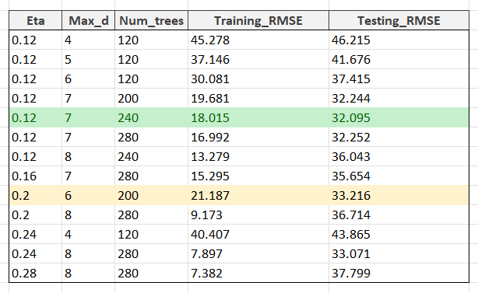
Boosting
Let’s go one more step further to get the best validation RMSE!
We considered minute changes about the “knobs” that gave us the best Validation RMSE in the first iteration.
We can keep refining the settings, but this is a significant minimum for the test RMSE.

Slide 29
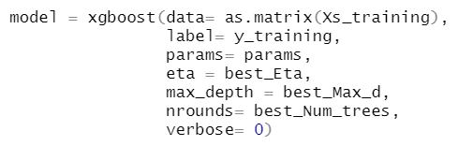
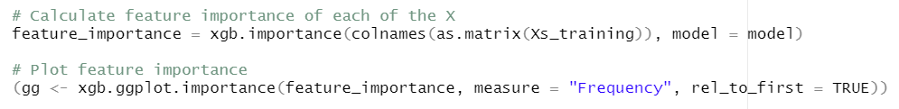
Boosting
Now, let’s see what we can interfere from the model with the best RMSE
We’ll calculate the feature importance for each feature (input)

Slide 30
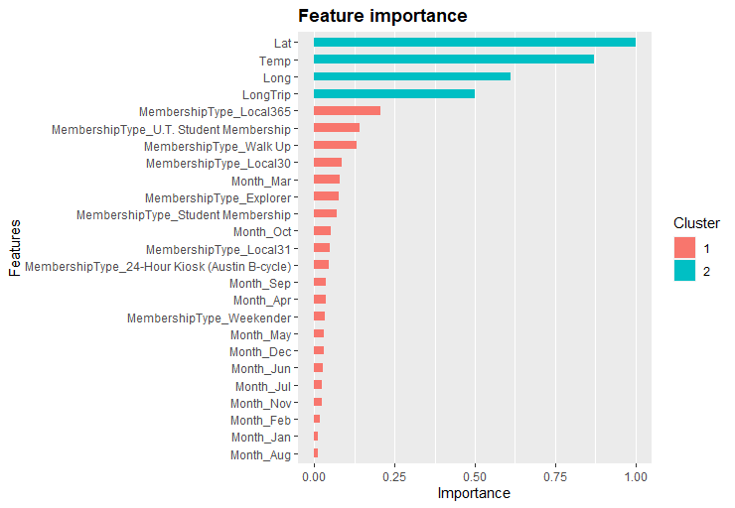
Boosting
What can we interpret from this Variable Importance Graph?
The top-4 variables are non-dummy variables,
Latitude
Temperature
Longitude
Long/Short Trip
Latitude has the most importance among all of them! This is clear if we consider the map of Austin!

Slide 31
Random Forests

Slide 32
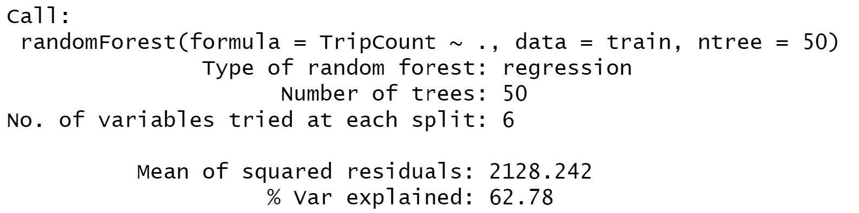
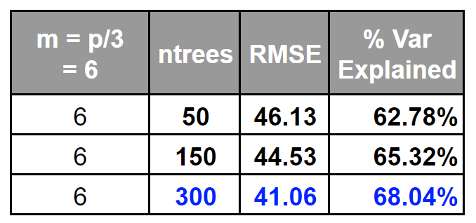
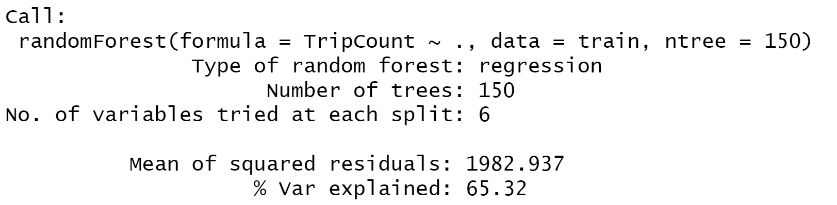
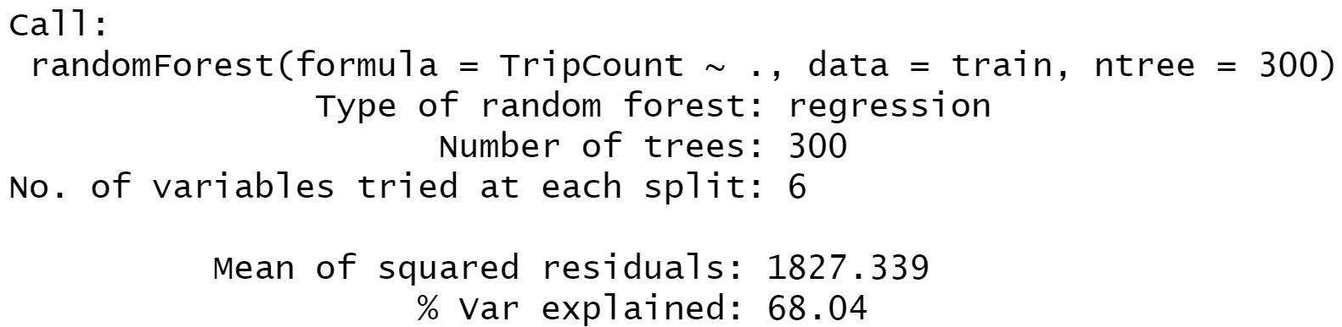
Random Forests at (B = 50, B = 150, B = 300) and (M=6) yield different results

Slide 33
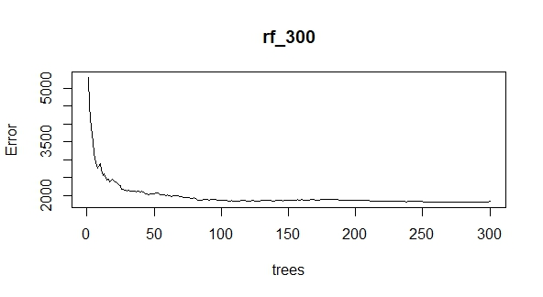
Random Forests begin to diminish returns a little over 100 trees

Slide 34
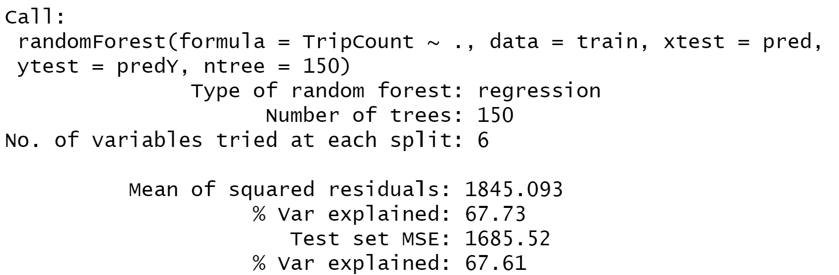
Cross-validating Random Forest (ntrees = 150) has reasonable results.
Validation RMSE = 41.06
Though the model is not optimal, the MSE in the test set is lower than the training set.
So OVERFITTING to noise is NOT LIKELY.
The Random Forests have some predictive value.

Slide 35
Bagging

Slide 36
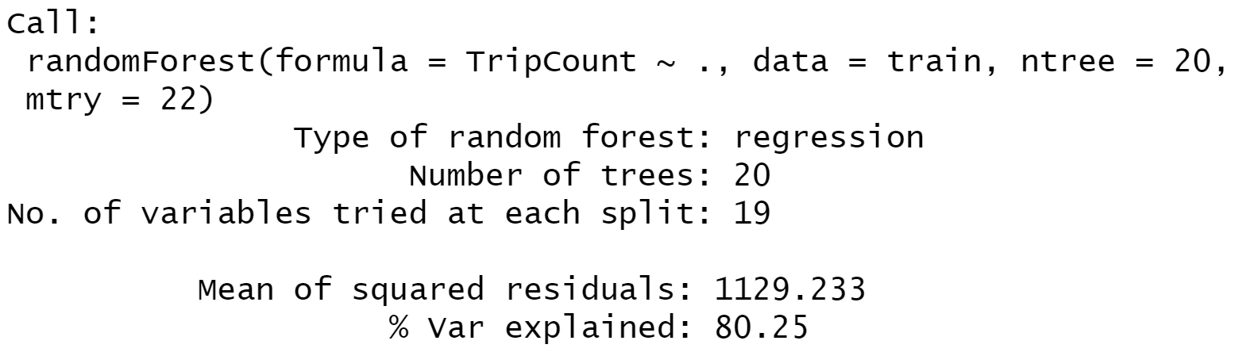
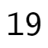
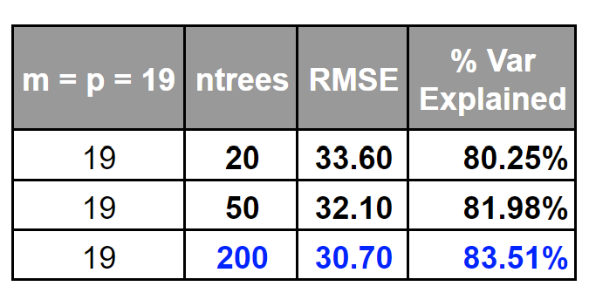
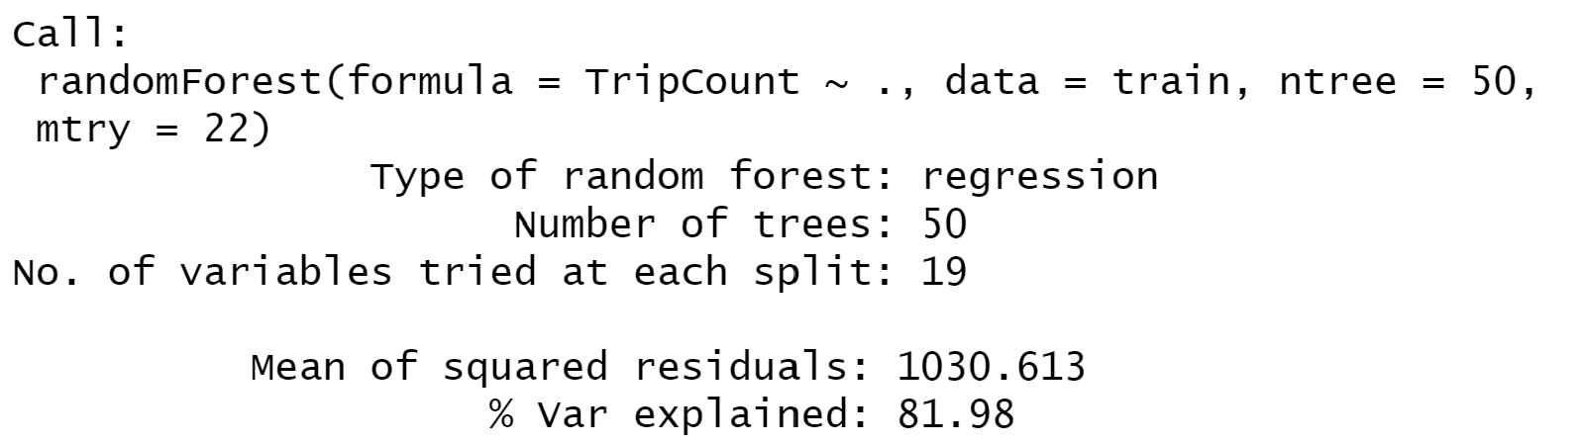
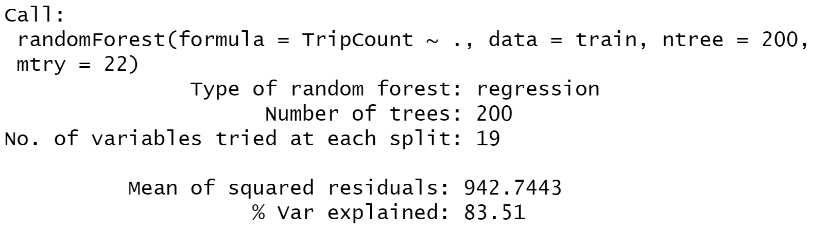
Bagging at (B = 20, B = 50, B = 200) yields different results

Slide 37
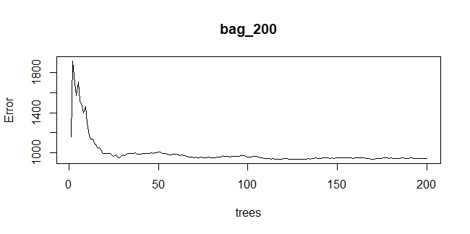
Bagging begins to diminish returns close to (B = 150)

Slide 38
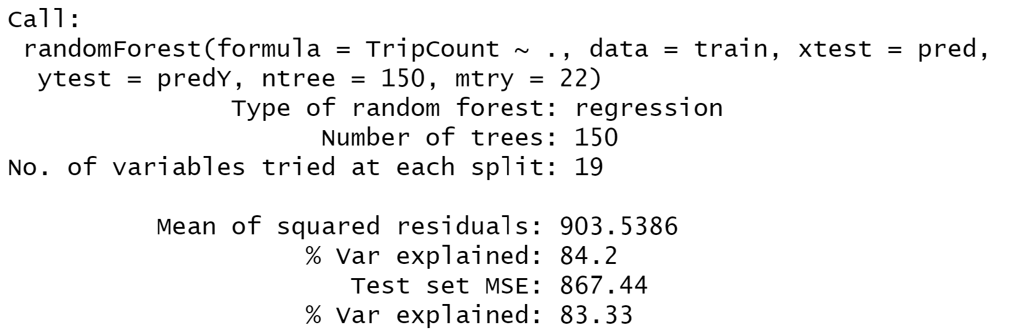
Cross-validating Bagging (B = 150) is strong!
Validation RMSE = 29.45!
Low RMSE with bagging signals that a large part of the variables should be important if not all.

Slide 39
Insights from Random Forests and Bagging
Nonparametric Models → Predictive Value for this data set
Bagging > Random Forests! → Most to all included variables are important
This makes sense: More than 50% of variables are indicators for month, and all 12 can be important for deciding to ride a bike regardless of temperature (vacations, festivals, school calendar, and other calendar-related variables approximated by month affect Austin’s population and behavior)

Slide 40
Recommendations
Create a new Bagging model with the following predictors:
Months
Membership type
Location
Use the model to:
-- Establish monthly supply standards at high volume stations, especially for valuable customer types.
-- Identify the right locations for promotions/ad campaigns for low volume months

Slide 41
THANK YOU!

Slide 42
Appendix

Slide 43
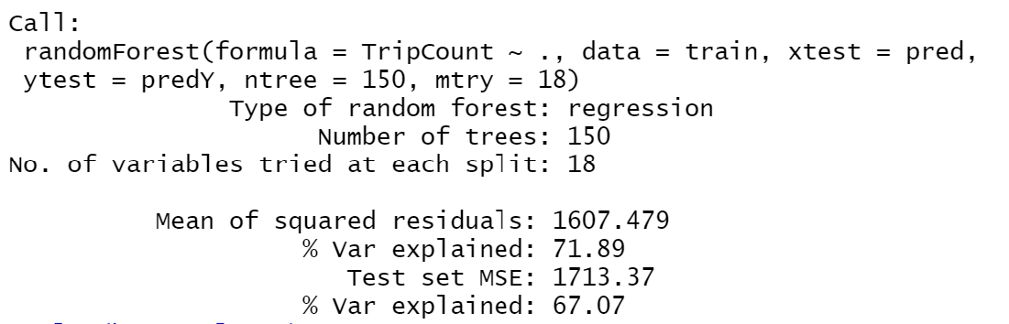
Cross-validating Bagging (B = 150) without Year as a Predictor
Validation RMSE = 41.4
A higher RMSE, but more relevant predictive power for future years.
Removes cuts where pathway will be impossible (eg. year < 2019)

Slide 44
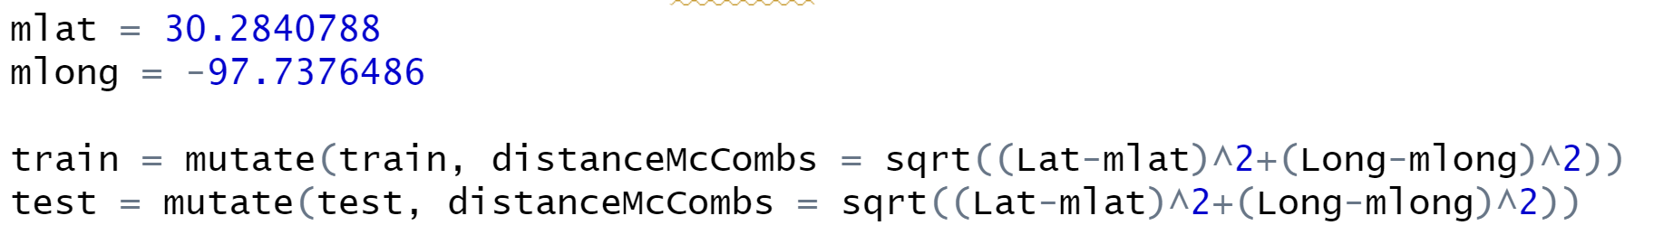
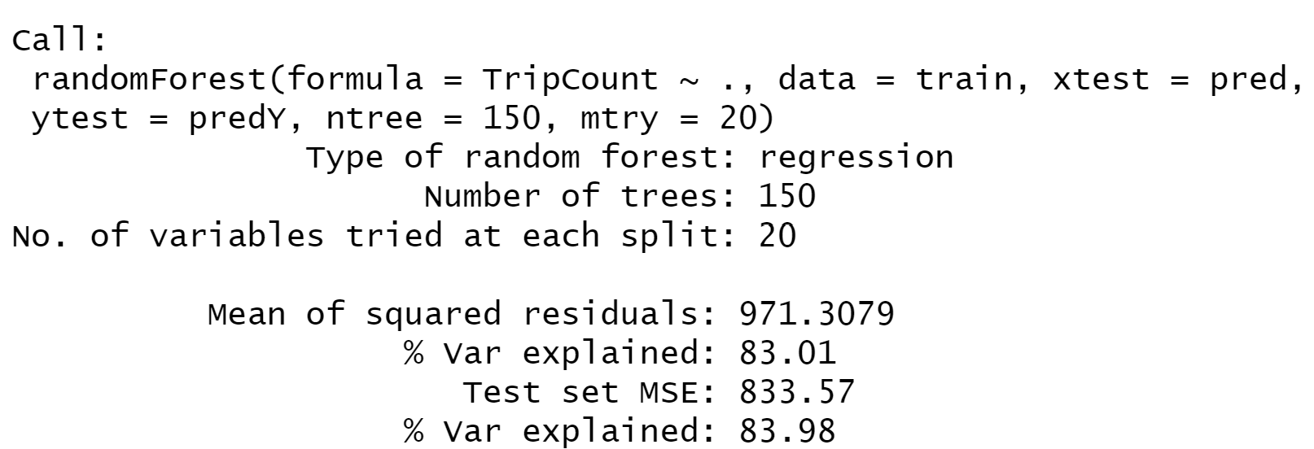
Cross-validating Bagging (B = 150) with McCombs
Validation RMSE = 28.87

Slide 45
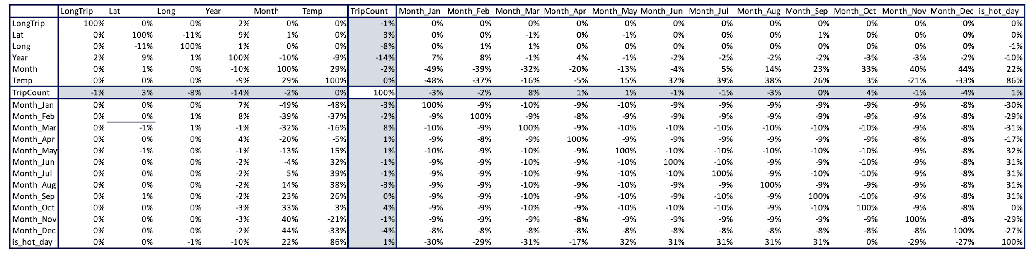
Correlation Matrix
The correlations between Trip volume and rest of the variables remains quite low

